Slide 1
CONCEPT
COsmological N-body CodE in PyThon
@ Heidelberg Institute for Theoretical Studies – 24-11-2015
By Jeppe Dakin

Slide 2
About me
Jeppe Dakin
Aarhus, Denmark
Master’s degree in physics this June
$→$ CONCEPT
PhD student from February (hopefully)

Slide 3
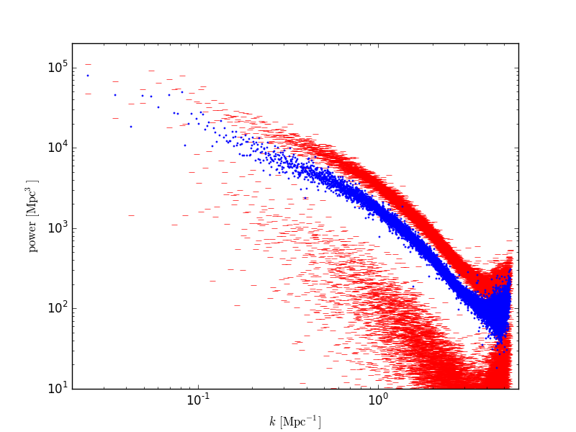
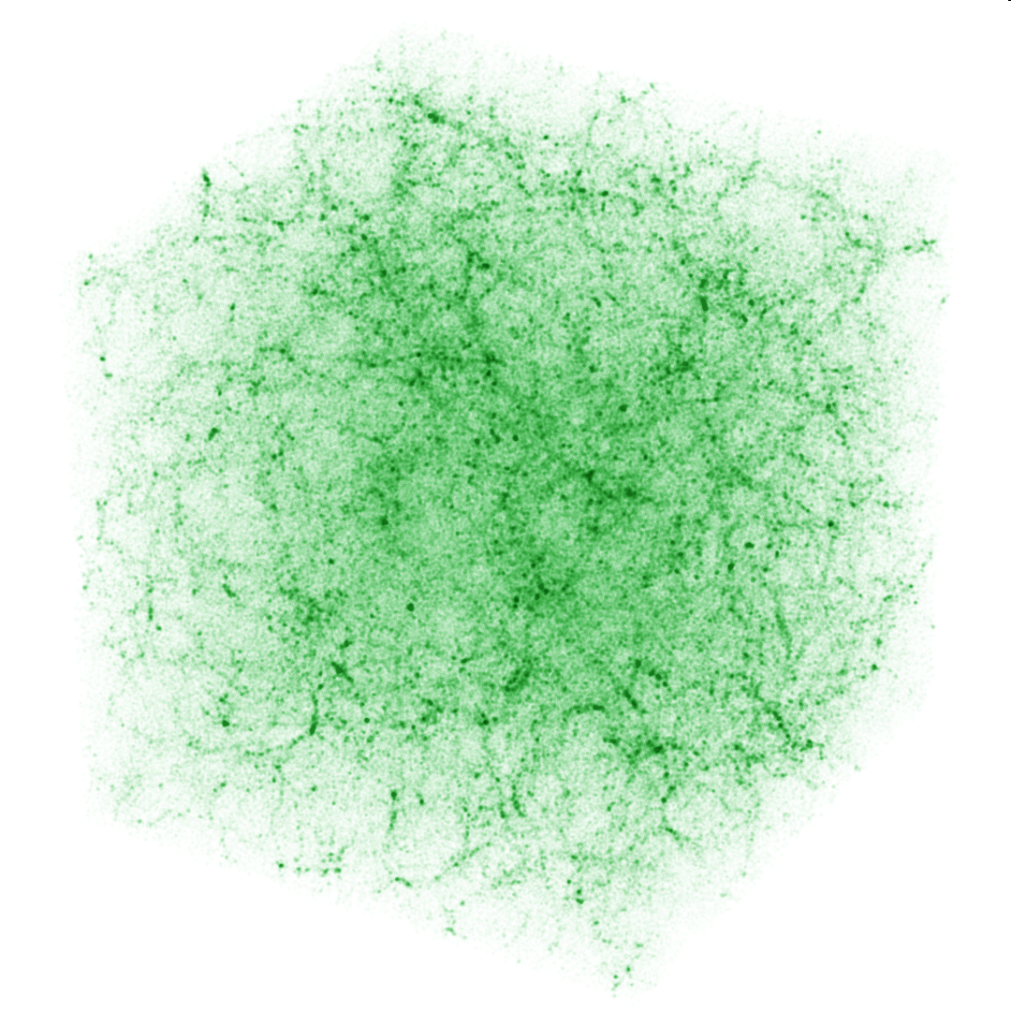
About CONCEPT
Cosmological N-body code
Species: Cold dark matter
Gravity: $PP$ (with or without Ewald), $PM$, $P^{3}M$
Time-stepping: Leapfrog
Snapshot format: Its own HDF5, Gadget’s 2nd format
Output
Snapshots
Power spectra
Renders
Terminal renders

Slide 4
Live demo
Installation
Parameters
Runs
Utilities

Slide 5
Cython
Pure Python to Cython: $∗.py$ $→$ $∗.pyx$ $+$ $∗.pxd$
Cythonization: $∗.pyx$ $+$ $∗.pxd$ $→$ $∗.c$
C-compilation and linking: $∗.pyx$ $+$ $∗.pxd$ $→$ $∗.c$ $→$ $∗.o$ $→$ $∗.so$
Why C?
Fast
Why Python?
Easy
Cython
C++ Fortran
Compilation

Slide 6
Structure of CONCEPT
concept
Makefile
Python Modules
Cython modules and headers
analysis.py,
commons.py,
communication.py, ewald.py, graphics.py, gravity.py, integration.py, main.py, mesh.py, snapshot.py,
species.py,
utilities.py
pyxpp.py
*.pyx
*.pxd
Shared definitions
Entry point. Main time loop
Additional utilities, not part of the simulation itself
C modules
fft.c
*.c
Cython
main.py
Compiled Python modules
*.so
mpicc

Slide 7
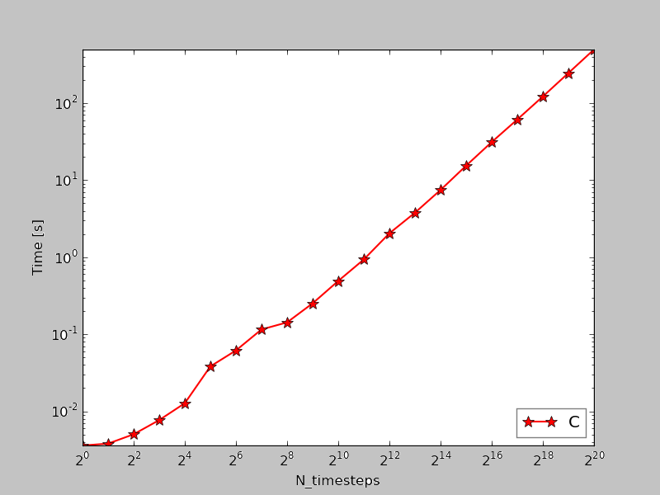
Comparison between C, Python, Cython

Slide 8
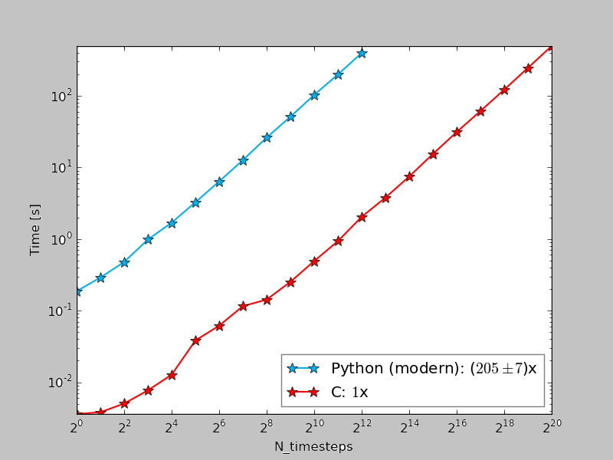
Comparison between C, Python, Cython

Slide 9
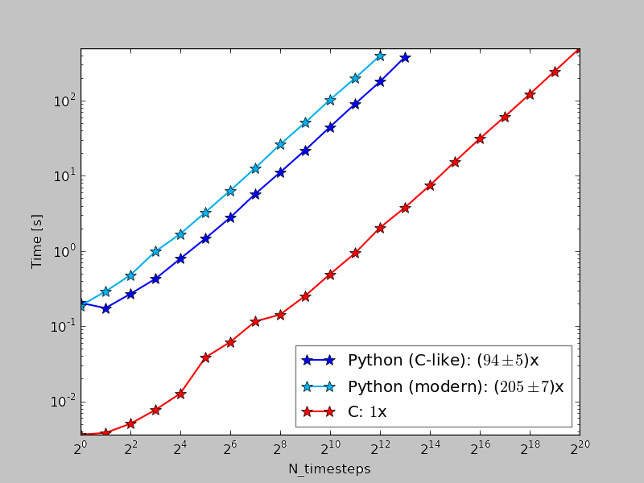
Comparison between C, Python, Cython

Slide 10
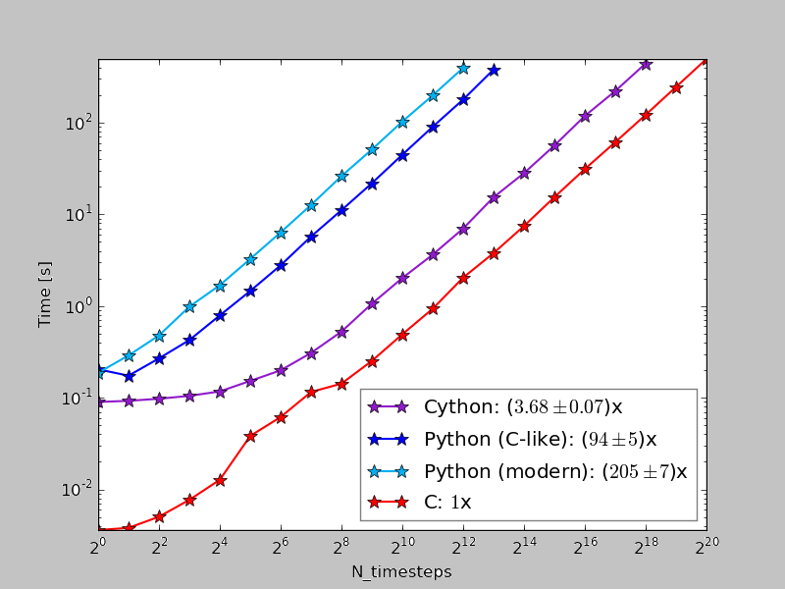
Comparison between C, Python, Cython

Slide 11
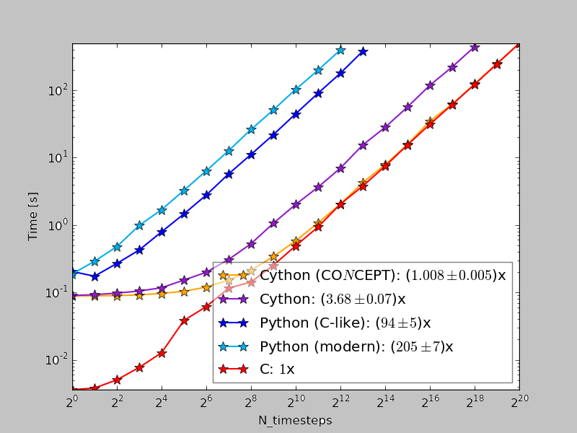
Comparison between C, Python, Cython

Slide 12
Why not stick to C only?
Generally much higher level with Python
General purpose containers: Lists, dictionaries, sets, …
“Everything” is an object
$⋯$
Automatic memory management
Garbage collection
Intelligent reallocation
Memoryviews (efficient, multi-dimensional arrays)
Array operations via NumPy (which wraps compiled C/C++/Fortran code)
Fully object oriented code
Huge number of packages (200 in PySL, 70k on PyPI)
Dynamic programming

Slide 13
Why not stick to C only?
Example of dynamic programming
Parameter file params_file
output_times = {
‘snapshot’ : 1,
‘powerspec’ : (2, 0.5, ‘3.14’, 9/7),
‘render’ : loadtxt(‘output_times.txt’),
‘terminal render’: [sin(i) for i in pi/2*linspace(0.05, 1, 8)] }
CONCEPT source file (commons.py)
params_ns = vars(numpy)
with open(‘params_file’) as params:
exec(params.read(), params_ns)
$$⋮$$
output_times = params_ns.get(‘output_times’, {})
$$⋮$$

Slide 14
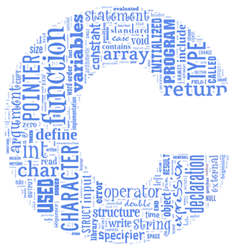
Special Python packages
Cython
MPI4Py
H5Py
Cython_GSL
(PyFFTW)
MPI
HDF5
GSL

Slide 15
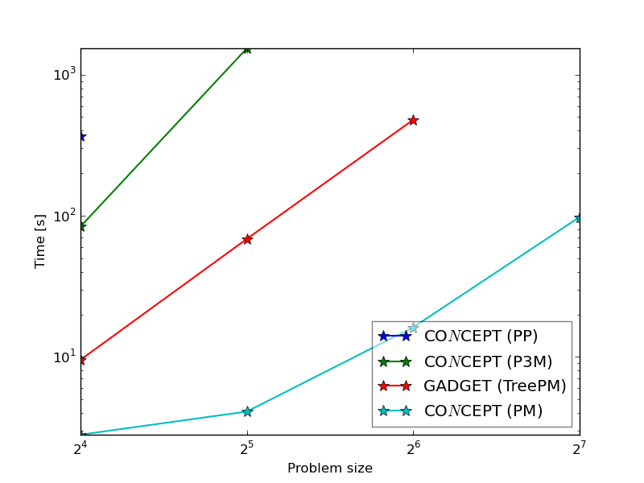
CONCEPT vs GADGET

Slide 16
Future plans for CONCEPT
None
Secret dreams
More sophisticated short-range gravitational algorithm
Intelligent time-stepping
Interplay with Blender for stunning visuals
(officially, anyway)

